Slide 1
Interview Question What are Jagged Arrays In Java?
momedaram

Slide 2
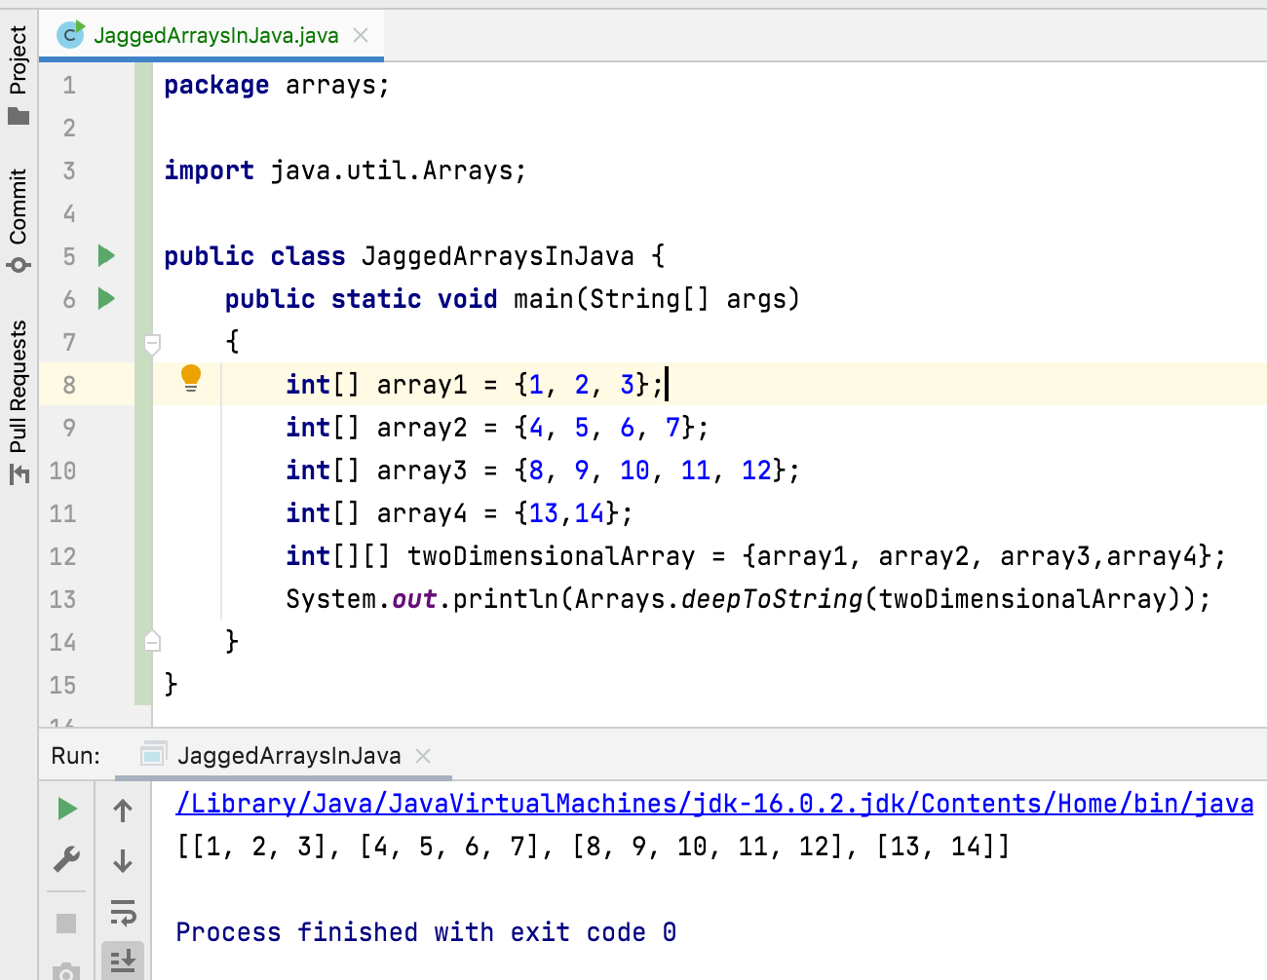
Jagged array / ragged arrays: An array containing arrays of different length.
Jagged arrays are also multidimensional arrays.

